Slide 1

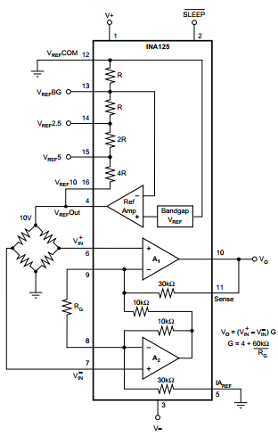
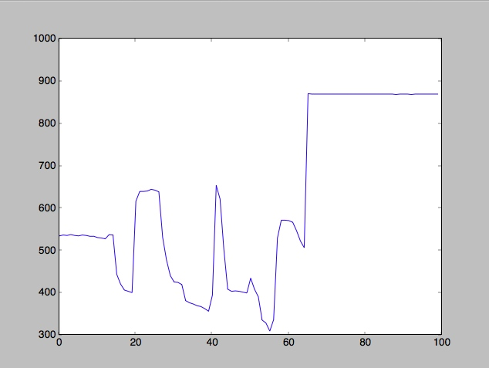
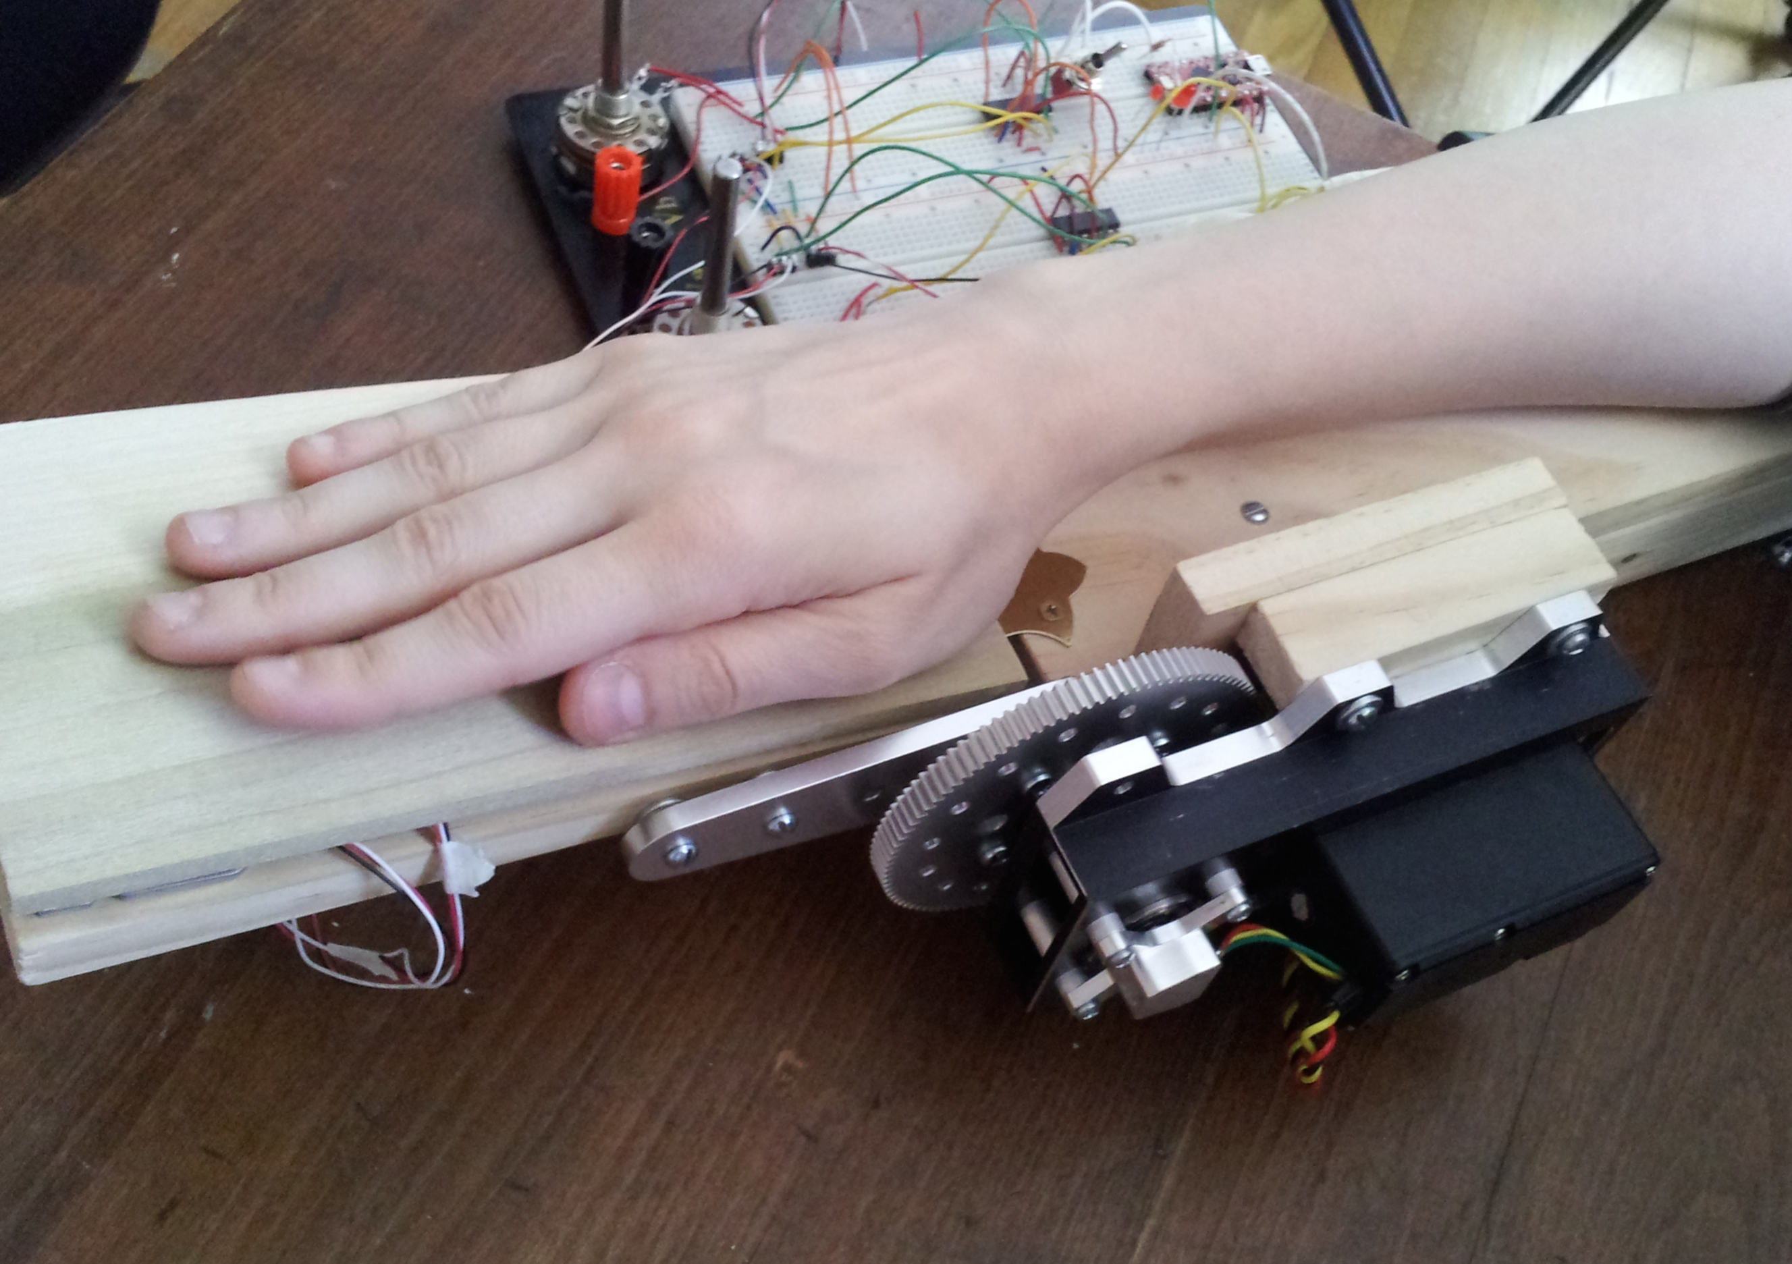
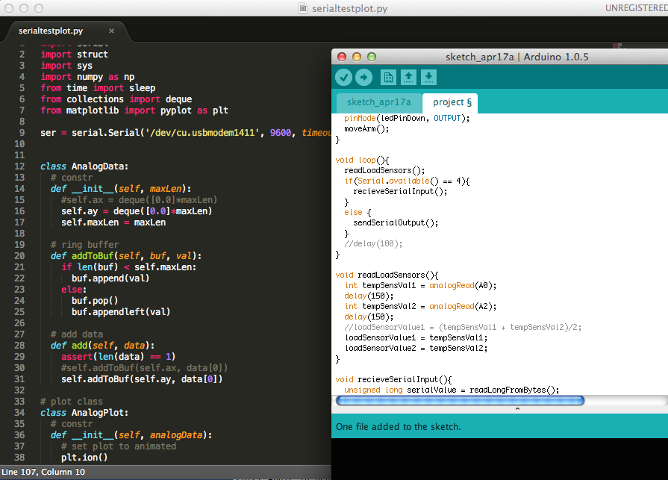
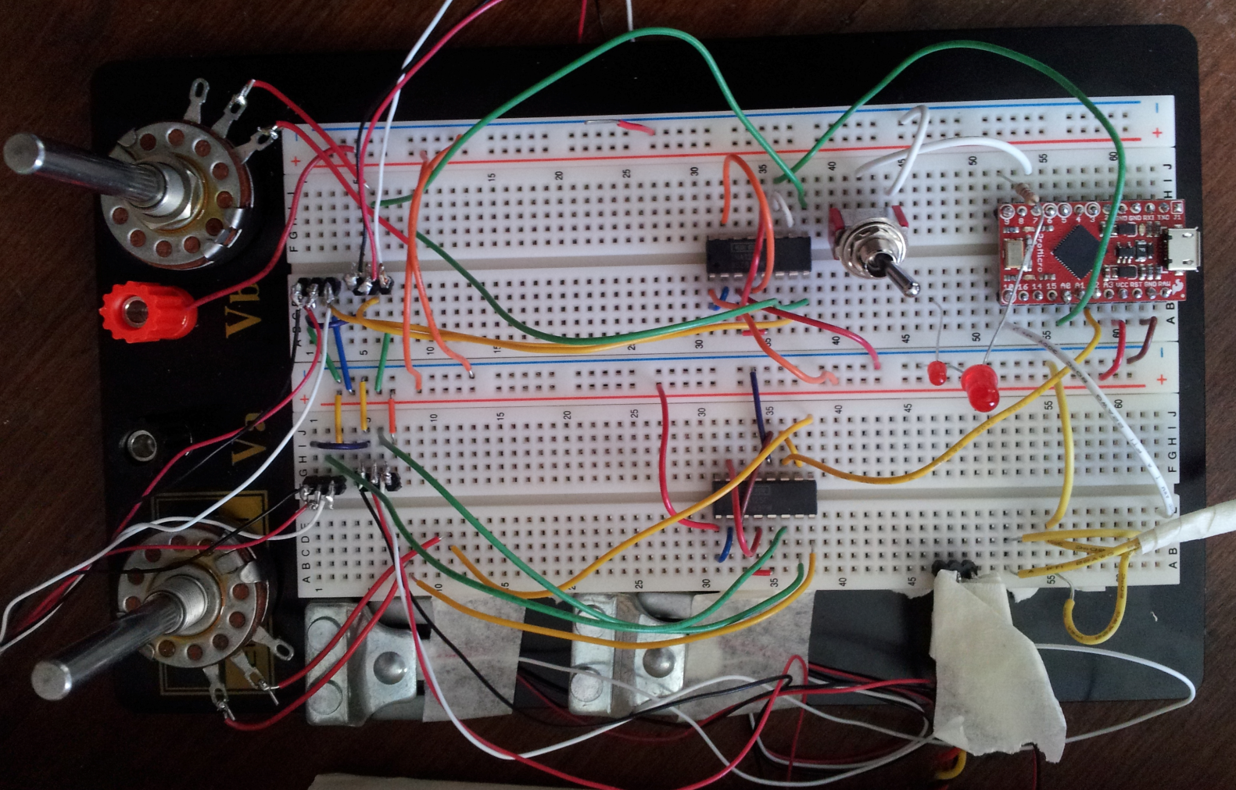
Human Interface Device for Rehabilitative Action on the Radiocarpal Joint
John Moffitt, Jennifer Schror
Advisor: Professor Burdea – Department of Electrical and Computer Engineering
Introduction
Hardware Overview
Injury and illness presents both an emotional and economic burden on the individual. This fact has not only spurred the increased growth of the physical therapy occupation in recent years but also the demand for more advanced rehabilitative devices. Technological developments have made robotic intervention increasingly affordable and commonplace. Through the use of engineering, patients can achieve desired range of motion, strength, and ultimately increased function despite injury.
Rotary Actuator & Power Supply
180°maximum rotation pulse width modulated servomotor
700 to 2300 μs range of motion
Regulated DC power supply at 4.8 V allows for 0.95sec/60°motion
1375 oz-in torque possible
LEDs indicate direction of motion and power
Fig. 2: INA125 and accompanying Wheatstone bridge setup
Objective
Design and construct a novel HID for rehabilitation directly aimed at injuries of the wrist during flexion and extension.
Implement a microcontroller based system for the control and movement of a motor.
Utilize a force sensor setup to measure applied palm pressure.
Create a software solution to aim and guide the patient in recovery.
Interface the micro-controller with computer to prompt the user to select angle of motion and direct to apply force
Microcontroller
5V/16 MHz Arduino with ATmega32U4
2 analog I/O for reading load sensor values
PWM capable pin allows for servomotor control
Half Bridge Force Sensors & Analog Circuit
4 50 kg load sensors
Complete Wheatstone bridge circuit to reduce temperature sensitivity
2 INA125P amplifier circuits to magnify and allow reading of output
Potentiometers as variable resistors create gain
Software
C/C++ based Arduino IDE and Python driven user interface
User sends servomotor pulse width range from 950 to 2150 μs to limit impractical motion
Python library pySerial incorporates bidirectional serial port reading/writing
Poll Arduino serial available between delays to read load sensor values
User may select angle or to measure intensity of force
Design
Fig. 5: Sample of Arduino and Python code
Fig. 3: Close-up view of circuit
Fig.4 : GUI illustrating variable force sensor values
References
Fig 1: Setup demonstrating wood base chosen to alleviate temperature fluctuations causing load sensor variation
[1] http://www.ti.com/lit/ds/symlink/ina125.pdf
[2] https://www.servocity.com/html/spg805a_standard_rotation.html

